Slide 1
Welcome to my project on the development of a hotel management system desktop application

Slide 2
Designed, and Presented by: Saba Ayodele

Slide 3
certificate
This is to certify that this project work titled
University of NIIT embodies the project done by Saba Ayodele in partial fulfilment of the course requirement in NIIT .

Slide 4
THE NEXT SET OF SLIDES CONTAIN IMAGES OF THE PAGES OF THE application DEVELOPED.

Slide 5
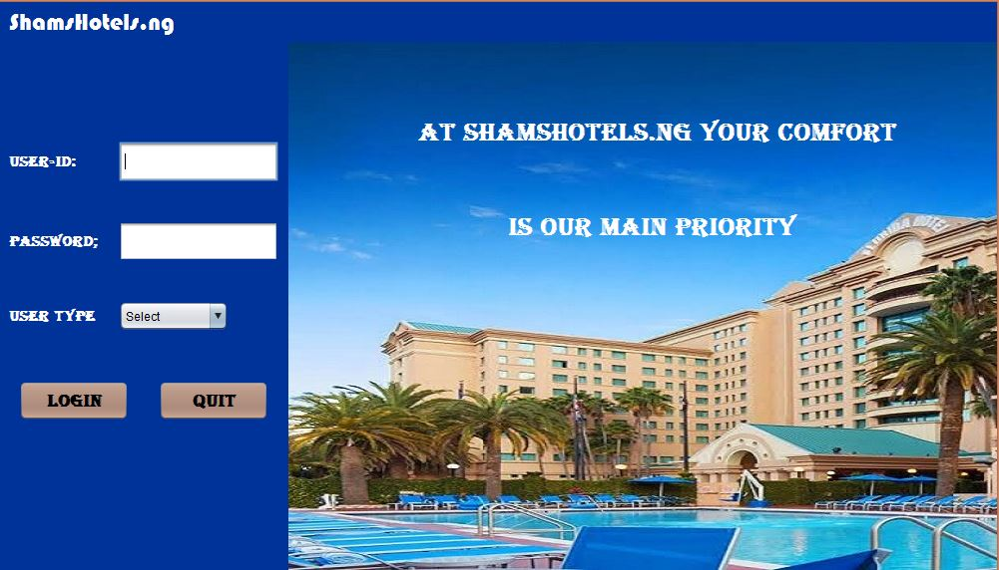
login PAGE

Slide 6
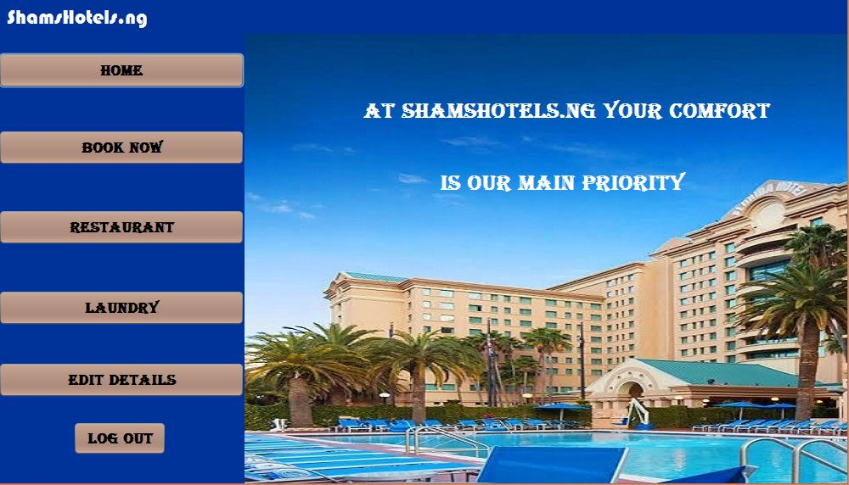
welcome PAGE

Slide 7
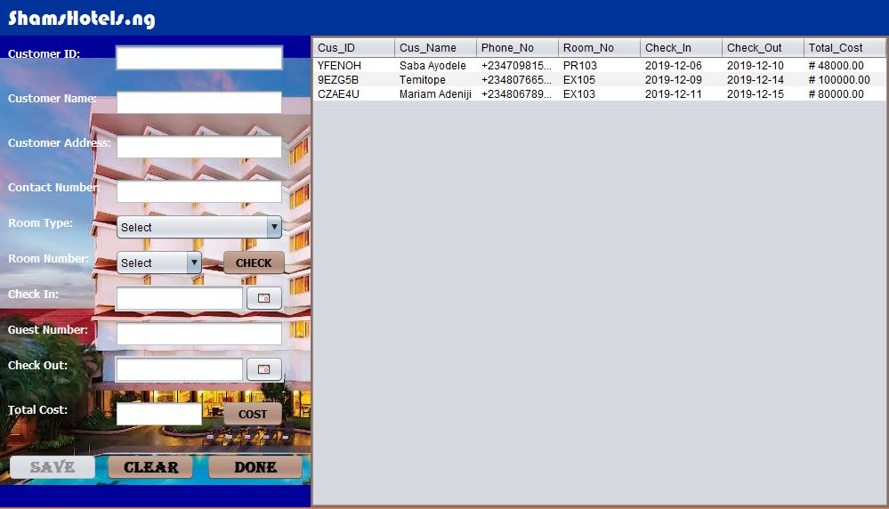
booking PAGE

Slide 8
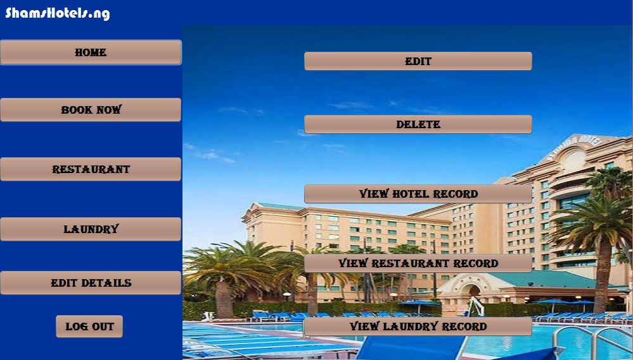
Edit details PAGE

Slide 9
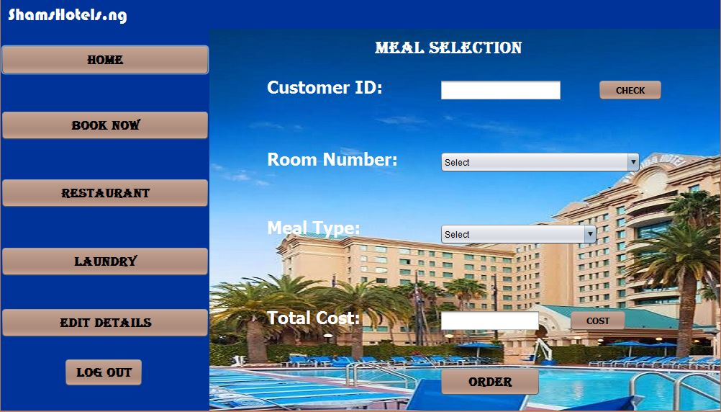
Restaurant services PAGE

Slide 10
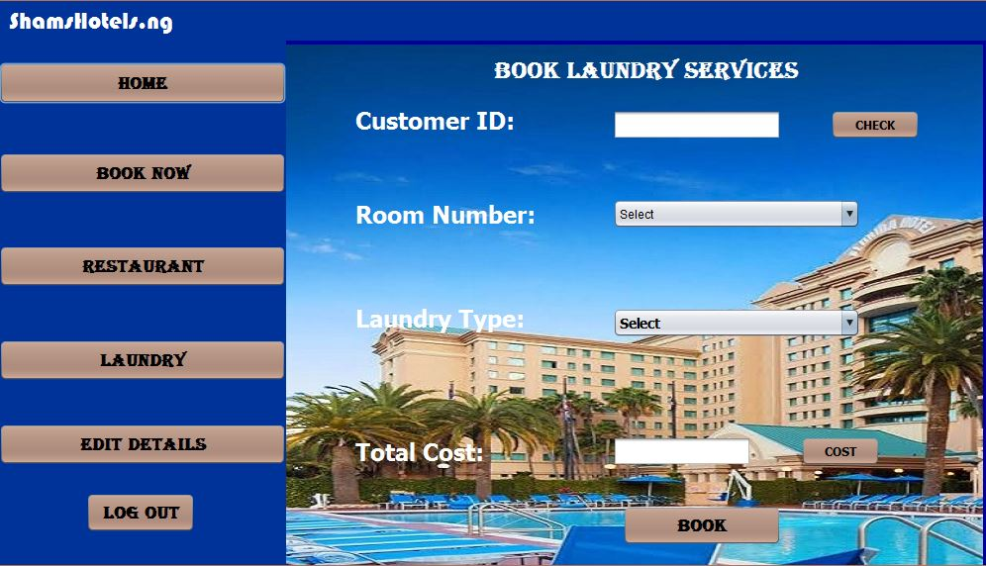
Laundry services PAGE

Slide 11
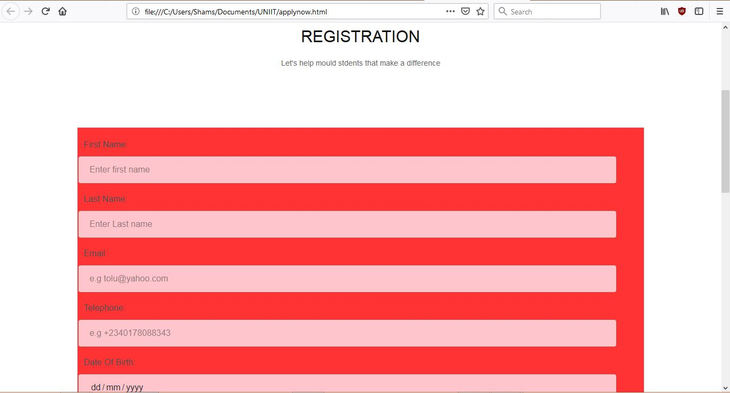
APPLY NOW PAGE

Slide 12
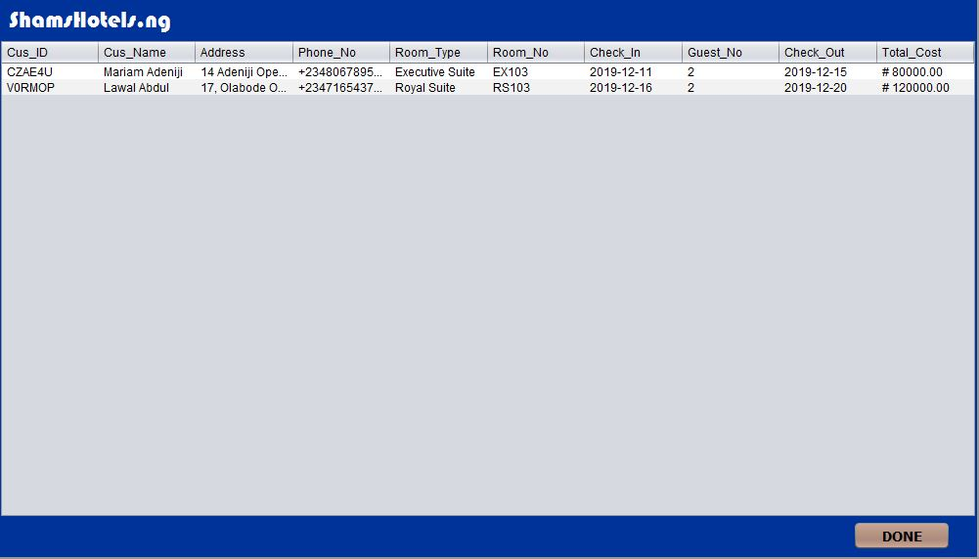
View records PAGE

Slide 13
challenges
Deciding on a design/colour to use in building the application.
Implementing functionality (YouTube videos were of great help with this).
Documentation.

Slide 14
Thank you.

